Slide 1
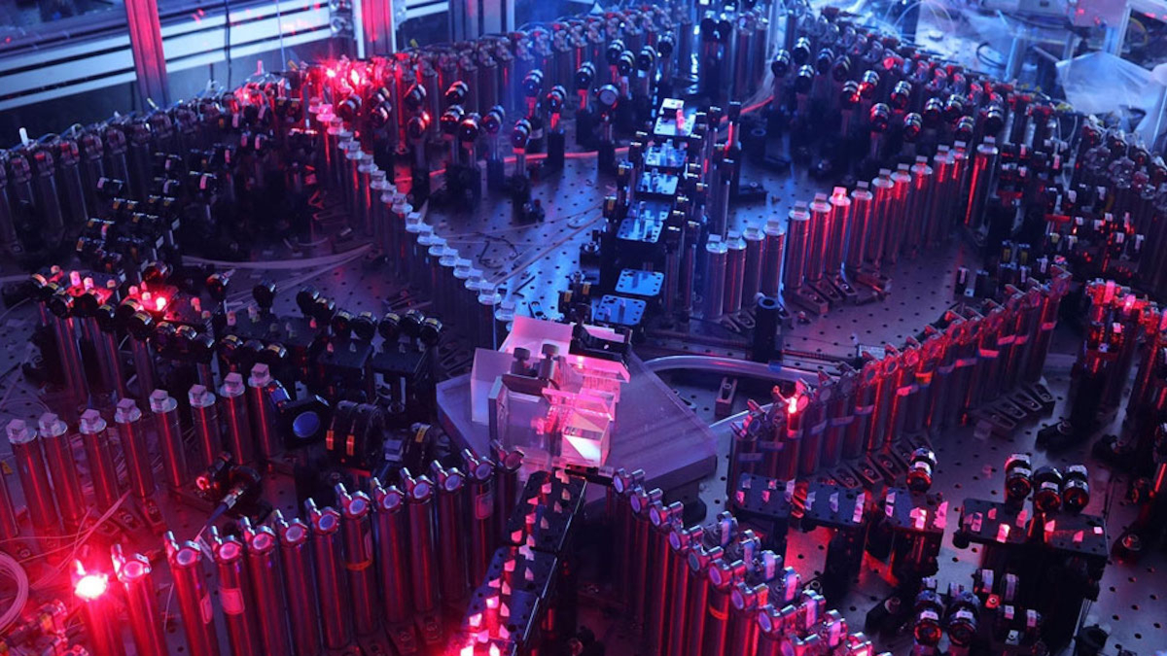
Quantum computers – a computing revolution
A promising discovery that will change the future

Slide 2
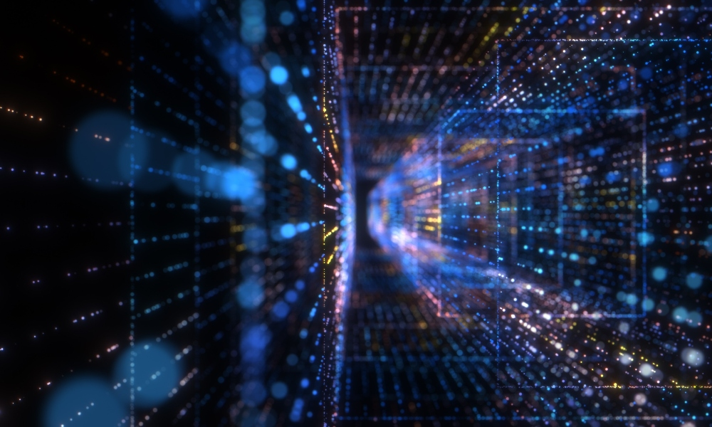
Presentation plan
Introduction – What is a quantum computer?
How it works – Qubits, superposition, and entanglement.
Breakthroughs and applications – Medicine, cryptography, AI.
Challenges and future – When will quantum computers become mainstream?
Conclusion – Why this discovery matters.

Slide 3
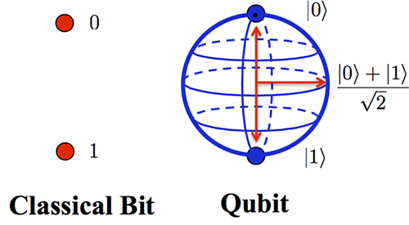
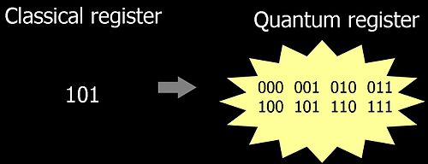
What is a quantum computer and how does it work?

Slide 4
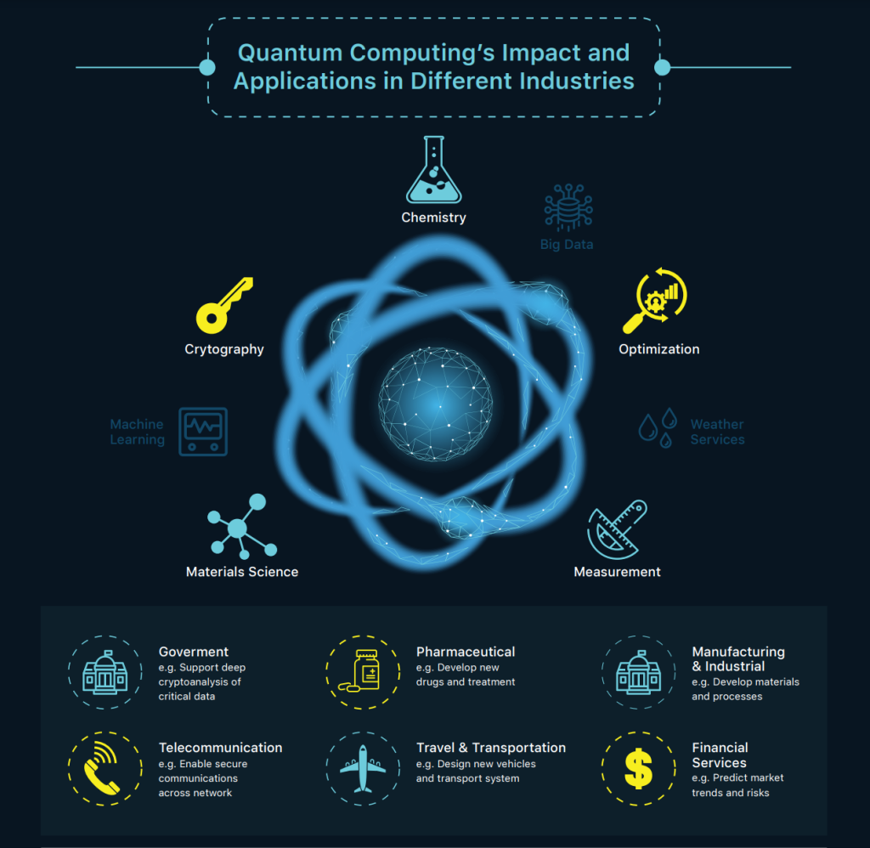
Problems of quantum computers
Decoherence
Scalability
Noise and errors
Cooling system
Lack of quantum algorithms
Cybersecurity risks

Slide 5
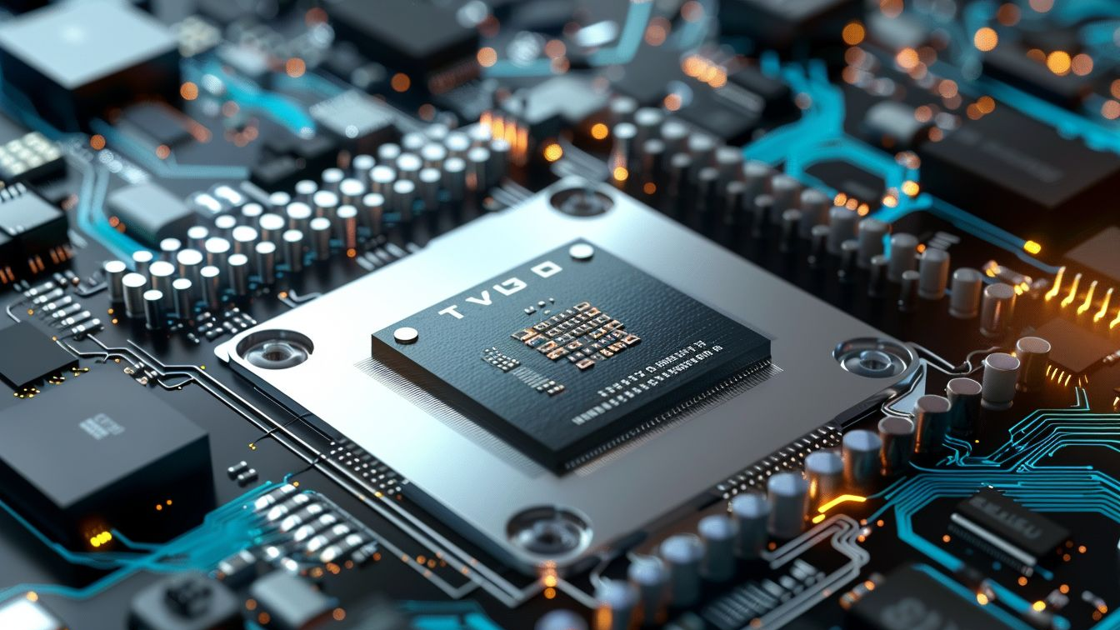
Thank you for your attention!

